Slide 1
Big Data Analytics in Manufacturing
Ark Mishara

Slide 2

Agenda
What is Big Data?
Business Challenges
How Big Data Revolutionizes Manufacturing
Big Data Use In Manufacturing
Why Companies Fail With Big Data
The Road Ahead

Slide 3
What is Big Data?
Extremely large data sets that may be analyzed computationally to reveal patterns, trends, and associations, especially relating to human behavior and interactions.

Slide 4
What is Big Data?
Extremely large data sets that may be analyzed computationally to reveal patterns, trends, and associations, especially relating to human behavior and interactions.
Volume
The quantity of generated and stored data

Slide 5
What is Big Data?
Extremely large data sets that may be analyzed computationally to reveal patterns, trends, and associations, especially relating to human behavior and interactions.
Volume
Variety
The quantity of generated and stored data
The type and nature of the data

Slide 6
What is Big Data?
Extremely large data sets that may be analyzed computationally to reveal patterns, trends, and associations, especially relating to human behavior and interactions.
Volume
Variety
Velocity
Speed at which data is generated and processed
The quantity of generated and stored data
The type and nature of the data

Slide 7
What is Big Data?
Extremely large data sets that may be analyzed computationally to reveal patterns, trends, and associations, especially relating to human behavior and interactions.
Volume
Variety
Velocity
Speed at which data is generated and processed
Variability
The quantity of generated and stored data
The type and nature of the data
Inconsistency of the data set

Slide 8
What is Big Data?
Extremely large data sets that may be analyzed computationally to reveal patterns, trends, and associations, especially relating to human behavior and interactions.
Volume
Variety
Velocity
Speed at which data is generated and processed
Variability
Veracity
The quantity of generated and stored data
The type and nature of the data
Inconsistency of the data set
Variance in the quality of captured data

Slide 9
Agenda
What is Big Data?
Business Challenges
How Big Data Revolutionizes Manufacturing
Big Data Use In Manufacturing
Why Companies Fail With Big Data
The Road Ahead

Slide 10












Who Uses Big Data?

Slide 11



Who Uses Big Data?

Slide 12






Business Challenges
Demand Uncertainty
Operational Complexity
How can I quickly respond to constantly shifting customer demand?
How do I create a flexible production environment that supports mass customization?
Suppliers
How do I simultaneously minimize costs and ensure consistently high quality?
How do I optimize the use of resources while balancing execution needs and production constraints ?
Customers
Your Company
Quality Expectation
Supply Chain Execution
How can I quickly respond to quality issues in manufacturing execution?
How do I reduce process variability?
How can I synchronize sales orders, purchases, and production?
How can I increase inventory velocity & customer service levels?

Slide 13
Agenda
What is Big Data?
Business Challenges
How Big Data Revolutionizes Manufacturing
Big Data Use In Manufacturing
Why Companies Fail With Big Data
The Road Ahead

Slide 14

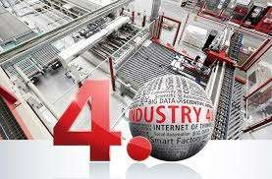
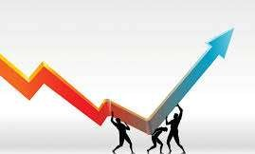
How Big Data Revolutionizes Manufacturing
Increasing the accuracy, quality and yield of biopharmaceutical production
Accelerating the integration
of IT, manufacturing and
Better forecasts of product demand and production
operational systems making the vision of Industry 4.0 a reality

Slide 15
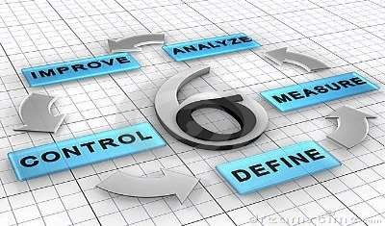

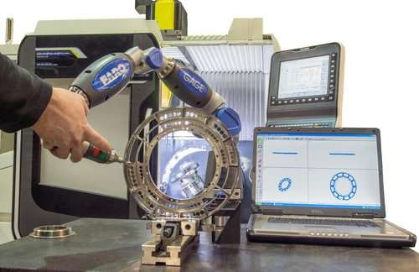
How Big Data Revolutionizes Manufacturing
Integrating advanced analytics
Greater visibility into supplier quality levels, and greater accuracy in predicting supplier performance over time
Measuring compliance and traceability to the machine
level becomes possible

Slide 16



How Big Data Revolutionizes Manufacturing
Selling only the most profitable
customized or build-to-order
configurations of products that
impact production the least
Quantify how daily production
impacts financial performance
with visibility to the machine
level
Service becomes strategic and a
contributor to customers’ goals by
monitoring products and
proactively providing preventative
maintenance recommendations

Slide 17
What It Means To Manufacturers

Slide 18

What It Means To Manufacturers
Margin Recovery - Savings are regularly found in reduced material costs and system capacity recovery

Slide 19

What It Means To Manufacturers
Margin Recovery - Savings are regularly found in reduced material costs and system capacity recovery
Product Quality and Safety - Teams are better equipped to understand and eliminate the true root causes of product risk

Slide 20
What It Means To Manufacturers
Margin Recovery - Savings are regularly found in reduced material costs and system capacity recovery
Product Quality and Safety - Teams are better equipped to understand and eliminate the true root causes of product risk
Eliminating overlapping investment and personnel support - Identifying overlap should result in the proper allocation of resources—both people and technology

Slide 21
What It Means To Manufacturers
Margin Recovery - Savings are regularly found in reduced material costs and system capacity recovery
Product Quality and Safety - Teams are better equipped to understand and eliminate the true root causes of product risk
Eliminating overlapping investment and personnel support - Identifying overlap should result in the proper allocation of resources—both people and technology
Collaboration – Big Data provides both macro and granular views of information that allows
management, operators and engineers to work together

Slide 22
What It Means To Manufacturers
Margin Recovery - Savings are regularly found in reduced material costs and system capacity recovery
Product Quality and Safety - Teams are better equipped to understand and eliminate the true root causes of product risk
Eliminating overlapping investment and personnel support - Identifying overlap should result in the proper allocation of resources—both people and technology
Collaboration – Big Data provides both macro and granular views of information that allows management, operators and engineers to work together
Monetizing Assets - In manufacturing, the move towards using big data has shifted the view of those assets and the systems that generate them as profit-enabling centers rather than just insurance and a cost of doing business

Slide 23
Agenda
What is Big Data?
Business Challenges
How Big Data Revolutionizes Manufacturing
Big Data Use In Manufacturing
Why Companies Fail With Big Data
The Road Ahead

Slide 24




Big Data Use Cases in Manufacturing
Improving Manufacturing Process
Custom Product Design
Inconsistency in quality and capacity of vaccine yield
Big Data aided in analyzing the behavior of repeat
customers
Big Data Analytics aided in identifying parameters that
had a direct impact on vaccine yield
Analyses helped in understanding how to deliver goods in a profitable manner
Modifying the target process helped the company to increase production by 50%, resulting in savings of
$10M
Used lean manufacturing principles to determine which products needed to be scrapped

Slide 25




Big Data Use Cases in Manufacturing
Better Quality Assurance
Managing Supply Chain Risk
Intel had to run 19000 tests on each chip produced
Used Big Data Analytics to analyze weather statistics for tornadoes, earthquakes etc.
Big Data Analytics aided in manufacturing process by
focusing on specific tests
Used the analytics findings to identify backup suppliers and contingency plans to avoid delays in production by natural disasters
Modifying the quality assurance process helped the company to save $3M in manufacturing costs

Slide 26
Agenda
What is Big Data?
Business Challenges
How Big Data Revolutionizes Manufacturing
Big Data Use In Manufacturing
Why Companies Fail With Big Data
The Road Ahead

Slide 27
Why Companies Fail With Big Data
Data Management
Organizational Silos
Capabilities
Sheer size of data
Restricted free flow of data between silos
Lack of Big Data Professionals
Quality issues with data
Getting the right talent is the biggest challenge
Restricted access and movement of data limits the ability of firms to capture data value
Data Complexity and interpretability
360 degree view of customer data across all products and services will give much better insights

Slide 28
Agenda
What is Big Data?
Business Challenges
How Big Data Revolutionizes Manufacturing
Big Data Use In Manufacturing
Why Companies Fail With Big Data
The Road Ahead

Slide 29

The Road Ahead

Slide 30



The Road Ahead
Hadoop-based storage platform

Slide 31


The Road Ahead
Lean Implementation
Hadoop-based storage platform

Slide 32


The Road Ahead
Internet of Things
Lean Implementation
Hadoop-based storage platform

